Slide 1
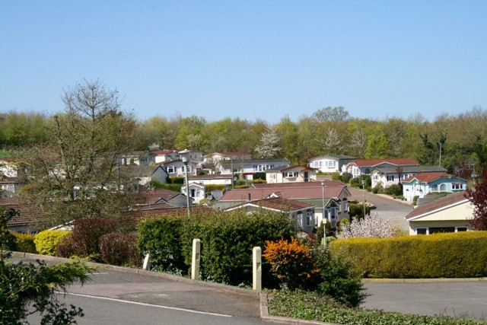
Blisworth Park, Station Road, Blisworth, NN7 3DS
*Photos are for illustration purposes only
Blisworth Park is set in attractive countryside on the outskirts of Blisworth village, the park is located between Northampton and the attractive market town of Towcester close to the A43 road and 4 miles from Junction 15 and 15A of the M1 motorway. The area is well situated for outdoor leisure activities including fishing, rambling and boating centred around the nearby Grand Union Canal. For sports enthusiast, Towcester racecourse, Silverstone circuit, Billing Aquadome and excellent golf courses may be reached within a short drive from the park.
Blisworth Village caters for basic needs and includes a supermarket, newsagent and an excellent group medical practice. A regular bus service provides access to larger stores and supermarkets, in Northampton.
Blisworth has a resident park manager to ensure peace of mind and security for all park residents.
Park Information
Permanent site licence
LPG Gas Supply
Regret no pets
10 year Gold Shield Warranty Scheme
Members of the British Holiday and Home Parks Association
No one under the age of 25 to be resident

Slide 2
Shops and local amenities
Blisworth
Blisworth village has a shop with a Post Office, offering a newspaper delivery service.
A doctors with a dispensing pharmacy is also in the village.
A fish and chip shop van and a mobile library come to the park.
Northampton and Surrounding areas
There is a dentist a 5 minute drive from the park in Northampton.
Northampton general is a 10 minute drive
Northampton and Towcester have the major supermarkets and shops, both of which are only a 10 minute drive.
Local Attractions
The Grand Union canal is in walking distance from the park and is perfect for fishing, boat trips and walking
Althorpe House is the famous home of Diana Princess of Wales and resting place is a 20 minute drive.
Silverstone race track is just a 15 minute drive away.
Northampton county cricket ground is only a few minutes away.
Out and About
There is a pub/hotel close to the park that offers excellent food, real ale and entertainment nights.
Northampton cinema complex is a 10 minute drive.
Transport
There is a bus stop outside the park entrance and a second bus stop a short walk from the park.
You can get to London from Northampton station in less than an hour.

